Slide 2
Learning Goals
LG1 Discuss the role of time value in finance, the use of computational tools, and the basic patterns of cash flow.
LG2 Understand the concepts of future value and present value, their calculation for single amounts, and the relationship between them.
LG3 Find the future value and the present value of both an ordinary annuity and an annuity due, and find the present value of a perpetuity.
© 2012 Pearson Prentice Hall. All rights reserved.
5-<number>

Slide 3
Learning Goals (cont.)
LG4 Calculate both the future value and the present value of a mixed stream of cash flows.
LG5 Understand the effect that compounding interest more frequently than annually has on future value and the effective annual rate of interest.
LG6 Describe the procedures involved in (1) determining deposits needed to accumulate a future sum, (2) loan amortization, (3) finding interest or growth rates, and (4) finding an unknown number of periods.
© 2012 Pearson Prentice Hall. All rights reserved.
5-<number>

Slide 4
The Role of Time Value in Finance
Most financial decisions involve costs & benefits that are spread out over time.
Time value of money allows comparison of cash flows from different periods.
Question: Your father has offered to give you some money and asks that you choose one of the following two alternatives:
  $1,000 today, or
  $1,100 one year from now.
What do you do?
© 2012 Pearson Prentice Hall. All rights reserved.
5-<number>

Slide 5

The Role of Time Value in Finance (cont.)
The answer depends on what rate of interest you could earn on any money you receive today.
For example, if you could deposit the $1,000 today at 12% per year, you would prefer to be paid today.
Alternatively, if you could only earn 5% on deposited funds, you would be better off if you chose the $1,100 in one year.
© 2012 Pearson Prentice Hall. All rights reserved.
5-<number>

Slide 6
Future Value versus Present Value
Suppose a firm has an opportunity to spend $15,000 today on some investment that will produce $17,000 spread out over the next five years as follows:
Is this a wise investment?
To make the right investment decision, managers need to compare the cash flows at a single point in time.
Year | Cash flow
1 | $3,000
2 | $5,000
3 | $4,000
4 | $3,000
5 | $2,000
© 2012 Pearson Prentice Hall. All rights reserved.
5-<number>

Slide 7
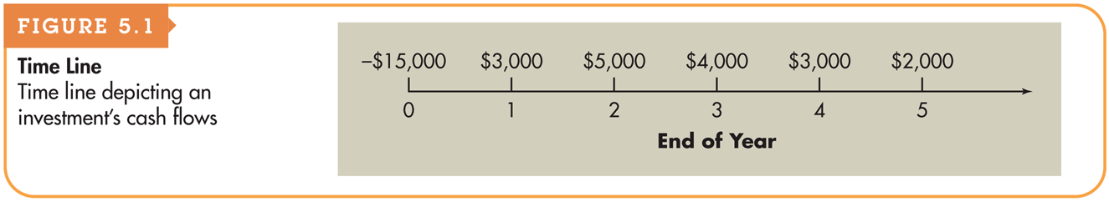
Figure 5.1
Time Line
© 2012 Pearson Prentice Hall. All rights reserved.
5-<number>

Slide 8
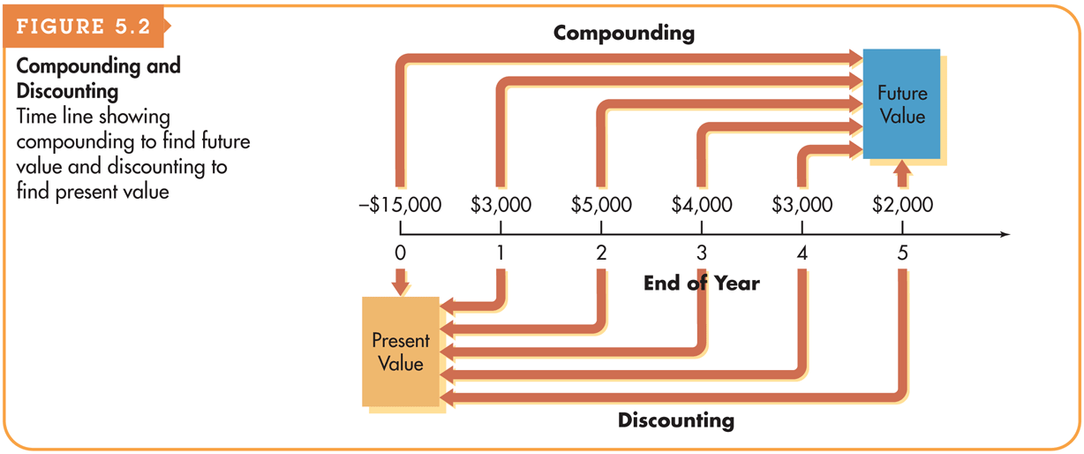
Figure 5.2
Compounding and Discounting
© 2012 Pearson Prentice Hall. All rights reserved.
5-<number>

Slide 9
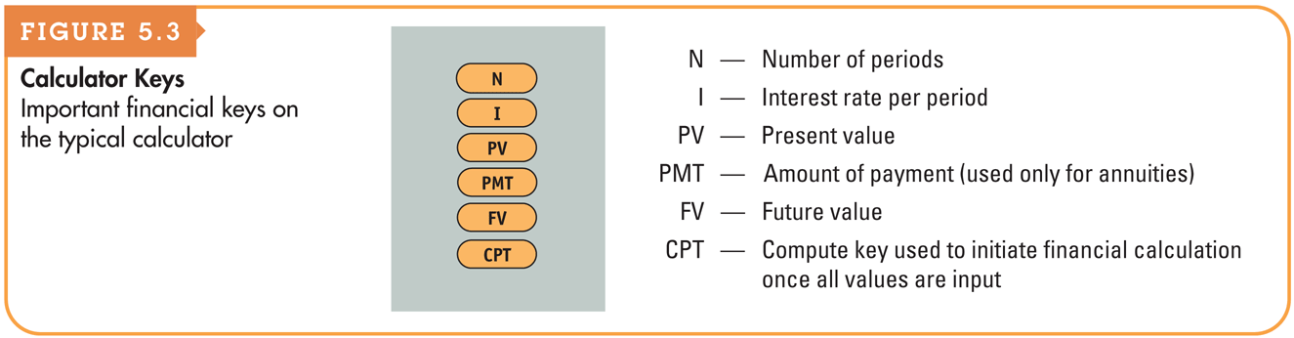
Figure 5.3
Calculator Keys
© 2012 Pearson Prentice Hall. All rights reserved.
5-<number>

Slide 10
Computational Tools (cont.)
Electronic spreadsheets:
  Like financial calculators, electronic spreadsheets have built-in routines that simplify time value calculations.
  The value for each variable is entered in a cell in the spreadsheet, and the calculation is programmed using an equation that links the individual cells.
  Changing any of the input variables automatically changes the solution as a result of the equation linking the cells.
© 2012 Pearson Prentice Hall. All rights reserved.
5-<number>

Slide 11
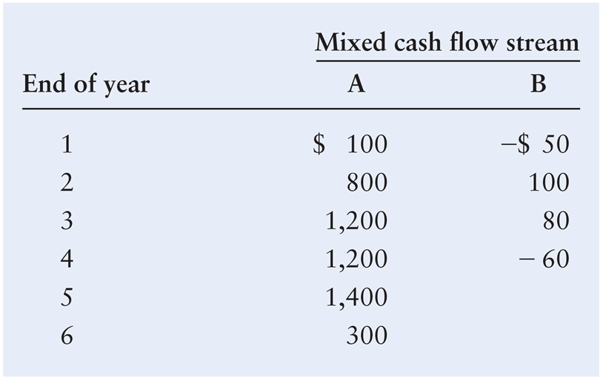
Basic Patterns of Cash Flow
The cash inflows and outflows of a firm can be described by its general pattern.
The three basic patterns include a single amount, an annuity, or a mixed stream:
© 2012 Pearson Prentice Hall. All rights reserved.
5-<number>

Slide 12
Future Value of a Single Amount
Future value is the value at a given future date of an amount placed on deposit today and earning interest at a specified rate. Found by applying compound interest over a specified period of time.
Compound interest is interest that is earned on a given deposit and has become part of the principal at the end of a specified period.
Principal is the amount of money on which interest is paid.
© 2012 Pearson Prentice Hall. All rights reserved.
5-<number>

Slide 13
Personal Finance Example
If Fred Moreno places $100 in a savings account paying 8% interest compounded annually, how much will he have at the end of 1 year?
  Future value at end of year 1 = $100 × (1 + 0.08) = $108
If Fred were to leave this money in the account for another year, how much would he have at the end of the second year?
  Future value at end of year 2 = $100 × (1 + 0.08) × (1 + 0.08)
  = $116.64
© 2012 Pearson Prentice Hall. All rights reserved.
5-<number>

Slide 14
Future Value of a Single Amount: The Equation for Future Value
We use the following notation for the various inputs:
  FV_{n} = future value at the end of period n
  PV = initial principal, or present value
  r = annual rate of interest paid. (Note: On financial calculators, I is typically used to represent this rate.)
  n = number of periods (typically years) that the money is left on deposit
The general equation for the future value at the end of period n is
FV_{n} = PV × (1 + r)^{n}
© 2012 Pearson Prentice Hall. All rights reserved.
5-<number>

Slide 15
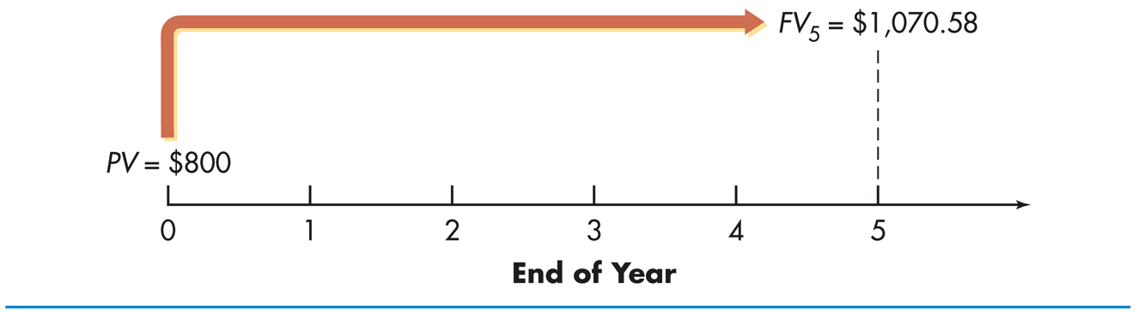
Future Value of a Single Amount: The Equation for Future Value
Jane Farber places $800 in a savings account paying 6% interest compounded annually. She wants to know how much money will be in the account at the end of five years.
This analysis can be depicted on a time line as follows:
FV₅ = $800 × (1 + 0.06)⁵ = $800 × (1.33823) = $1,070.58
© 2012 Pearson Prentice Hall. All rights reserved.
5-<number>

Slide 16
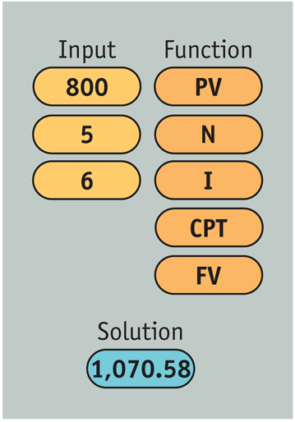
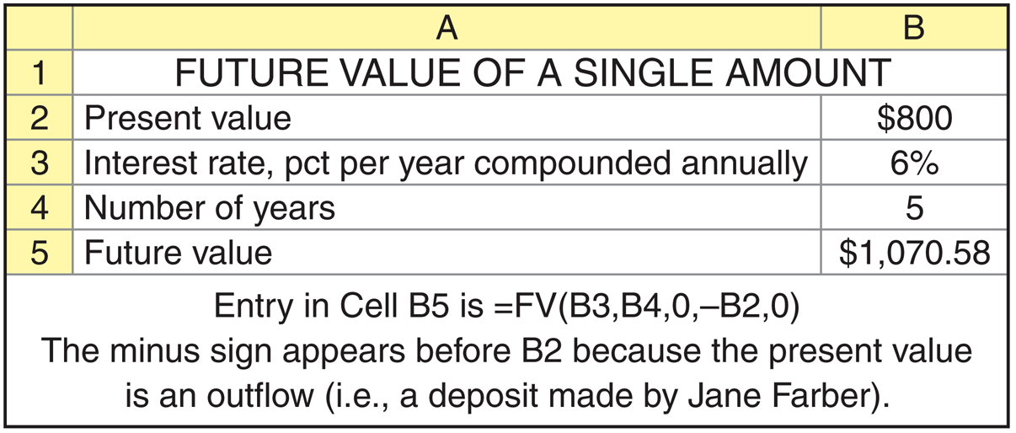
Personal Finance Example
© 2012 Pearson Prentice Hall. All rights reserved.
5-<number>

Slide 17
Present Value of a Single Amount
Present value is the current dollar value of a future amount—the amount of money that would have to be invested today at a given interest rate over a specified period to equal the future amount.
It is based on the idea that a dollar today is worth more than a dollar tomorrow.
Discounting cash flows is the process of finding present values; the inverse of compounding interest.
The discount rate is often also referred to as the opportunity cost, the discount rate, the required return, or the cost of capital.
© 2012 Pearson Prentice Hall. All rights reserved.
5-<number>

Slide 18
Personal Finance Example
Paul Shorter has an opportunity to receive $300 one year from now. If he can earn 6% on his investments, what is the most he should pay now for this opportunity?
PV × (1 + 0.06) = $300
PV = $300/(1 + 0.06) = $283.02
© 2012 Pearson Prentice Hall. All rights reserved.
5-<number>

Slide 19

Present Value of a Single Amount: The Equation for Present Value
The present value, PV, of some future amount, FV_{n}, to be received n periods from now, assuming an interest rate (or opportunity cost) of r, is calculated as follows:
© 2012 Pearson Prentice Hall. All rights reserved.
5-<number>

Slide 20
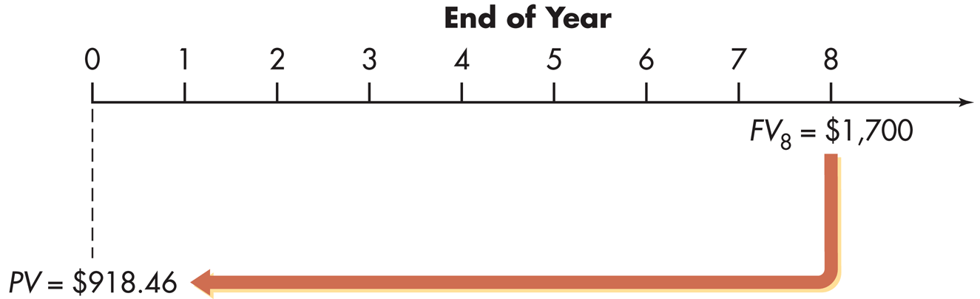
Present Value of a Single Amount: The Equation for Future Value
Pam Valenti wishes to find the present value of $1,700 that will be received 8 years from now. Pam’s opportunity cost is 8%.
This analysis can be depicted on a time line as follows:
PV = $1,700/(1 + 0.08)⁸ = $1,700/1.85093 = $918.46
© 2012 Pearson Prentice Hall. All rights reserved.
5-<number>

Slide 21
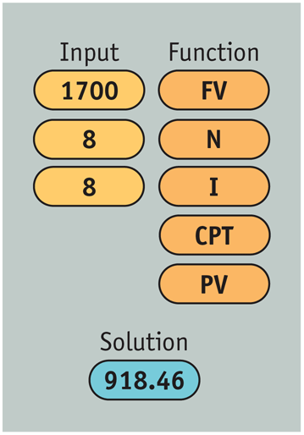
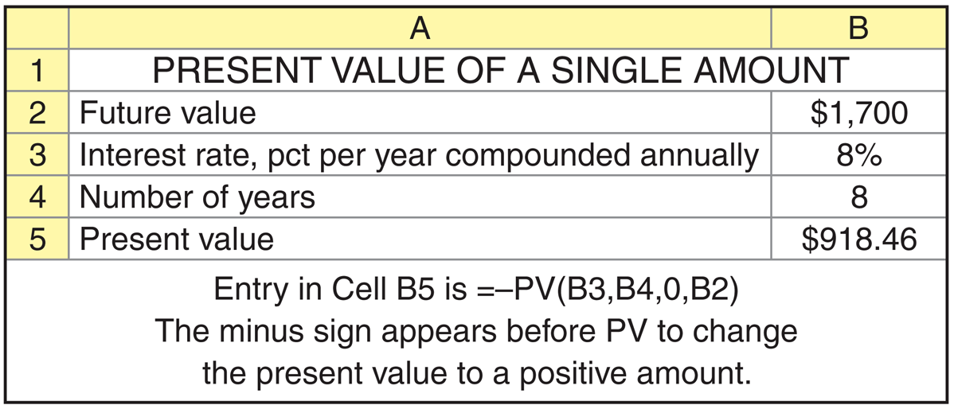
Personal Finance Example
© 2012 Pearson Prentice Hall. All rights reserved.
5-<number>

Slide 22
Annuities
An annuity is a stream of equal periodic cash flows, over a specified time period. These cash flows can be inflows of returns earned on investments or outflows of funds invested to earn future returns.
  An ordinary (deferred) annuity is an annuity for which the cash flow occurs at the end of each period
  An annuity due is an annuity for which the cash flow occurs at the beginning of each period.
  An annuity due will always be greater than an otherwise equivalent ordinary annuity because interest will compound for an additional period.
© 2012 Pearson Prentice Hall. All rights reserved.
5-<number>

Slide 23
Personal Finance Example
Fran Abrams is choosing which of two annuities to receive. Both are 5-year $1,000 annuities; annuity A is an ordinary annuity, and annuity B is an annuity due. Fran has listed the cash flows for both annuities as shown in Table 5.1 on the following slide.
Note that the amount of both annuities total $5,000.
© 2012 Pearson Prentice Hall. All rights reserved.
5-<number>

Slide 24
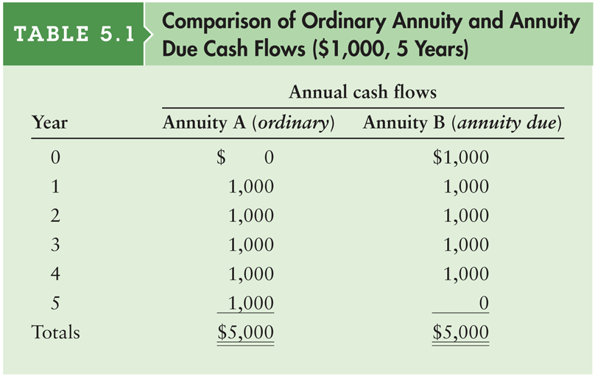
Table 5.1 Comparison of Ordinary Annuity and Annuity Due Cash Flows ($1,000, 5 Years)
© 2012 Pearson Prentice Hall. All rights reserved.
5-<number>

Slide 25

Finding the Future Value of an Ordinary Annuity
You can calculate the future value of an ordinary annuity that pays an annual cash flow equal to CF by using the following equation:
As before, in this equation r represents the interest rate and n represents the number of payments in the annuity (or equivalently, the number of years over which the annuity is spread).
© 2012 Pearson Prentice Hall. All rights reserved.
5-<number>

Slide 26

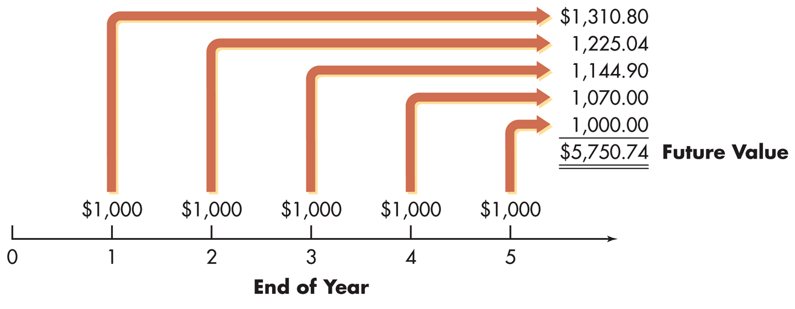
Personal Finance Example
Fran Abrams wishes to determine how much money she will have at the end of 5 years if he chooses annuity A, the ordinary annuity and it earns 7% annually. Annuity A is depicted graphically below:
This analysis can be depicted on a time line as follows:
© 2012 Pearson Prentice Hall. All rights reserved.
5-<number>

Slide 27
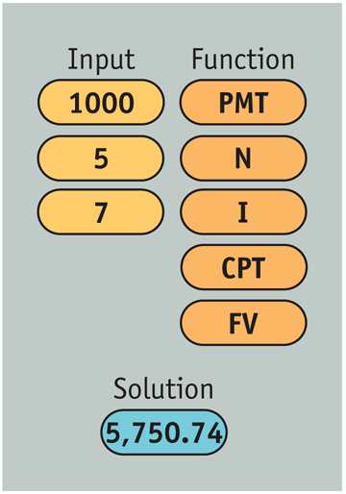
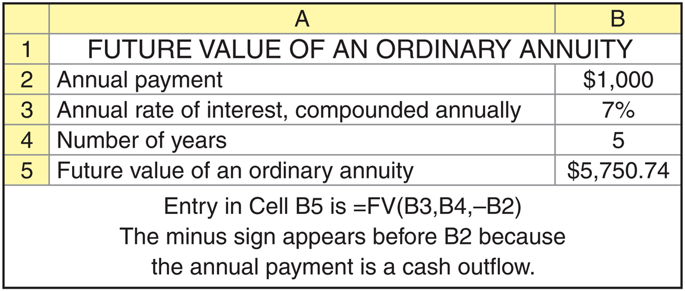
Personal Finance Example (cont.)
© 2012 Pearson Prentice Hall. All rights reserved.
5-<number>

Slide 28

Finding the Present Value of an Ordinary Annuity
You can calculate the present value of an ordinary annuity that pays an annual cash flow equal to CF by using the following equation:
As before, in this equation r represents the interest rate and n represents the number of payments in the annuity (or equivalently, the number of years over which the annuity is spread).
© 2012 Pearson Prentice Hall. All rights reserved.
5-<number>

Slide 29
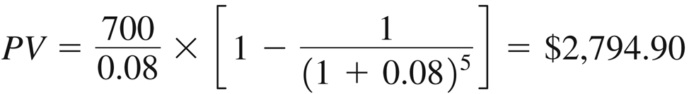
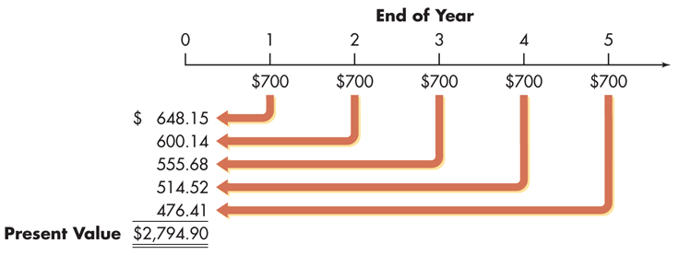
Finding the Present Value of an Ordinary Annuity (cont.)
Braden Company, a small producer of plastic toys, wants to determine the most it should pay to purchase a particular annuity. The annuity consists of cash flows of $700 at the end of each year for 5 years. The required return is 8%.
This analysis can be depicted on a time line as follows:
© 2012 Pearson Prentice Hall. All rights reserved.
5-<number>

Slide 30
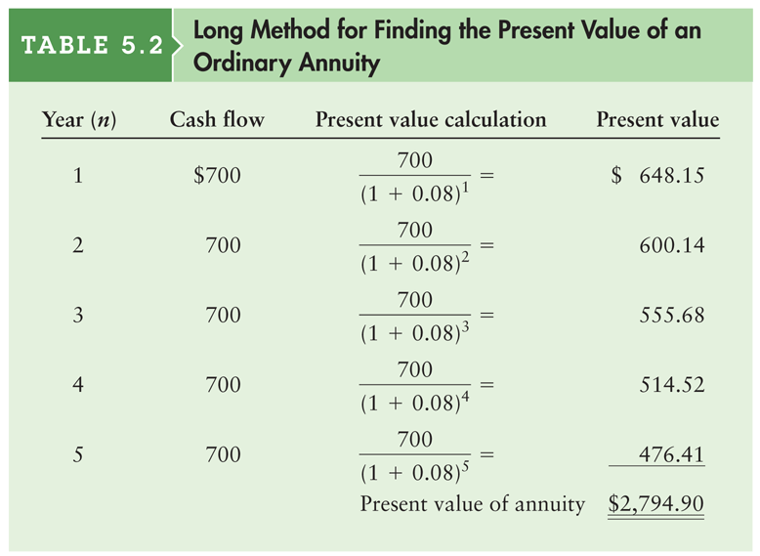
Table 5.2 Long Method for Finding the Present Value of an Ordinary Annuity
© 2012 Pearson Prentice Hall. All rights reserved.
5-<number>

Slide 31
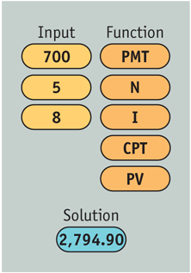
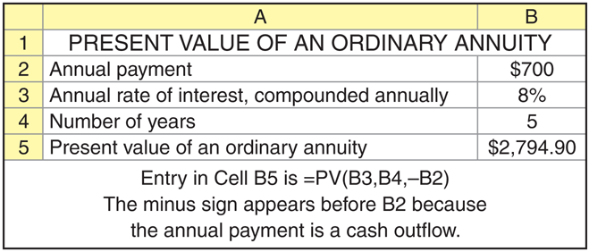
Finding the Present Value of an Ordinary Annuity (cont.)
© 2012 Pearson Prentice Hall. All rights reserved.
5-<number>

Slide 32

Finding the Future Value of an Annuity Due
You can calculate the present value of an annuity due that pays an annual cash flow equal to CF by using the following equation:
As before, in this equation r represents the interest rate and n represents the number of payments in the annuity (or equivalently, the number of years over which the annuity is spread).
© 2012 Pearson Prentice Hall. All rights reserved.
5-<number>

Slide 33
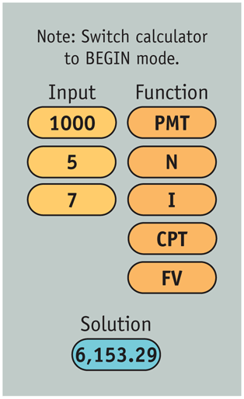
Personal Finance Example
Fran Abrams now wishes to calculate the future value of an annuity due for annuity B in
Table 5.1. Recall that annuity B was a 5 period annuity with the first annuity beginning immediately.
Note: Before using your calculator to find the future value of an annuity due, depending on the specific calculator, you must either switch it to BEGIN mode or use the DUE key.
© 2012 Pearson Prentice Hall. All rights reserved.
5-<number>

Slide 34
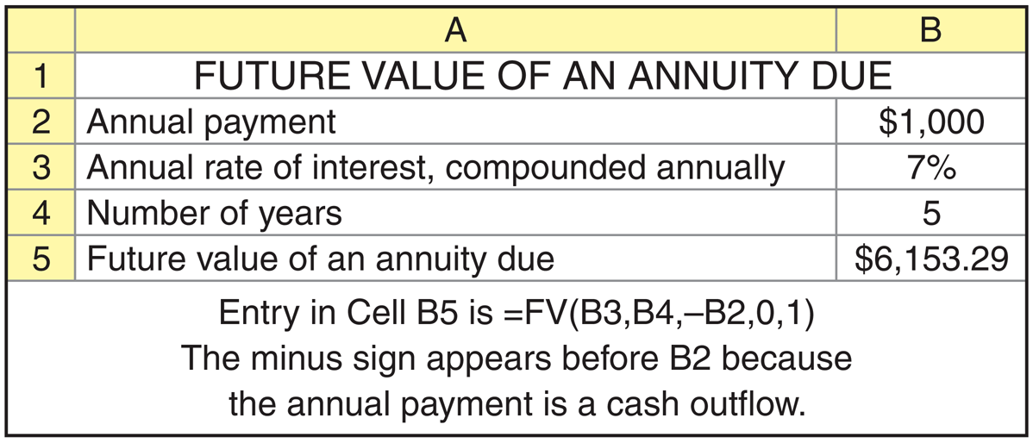
Personal Finance Example (cont.)
© 2012 Pearson Prentice Hall. All rights reserved.
5-<number>

Slide 35

Finding the Present Value of an Annuity Due
You can calculate the present value of an ordinary annuity that pays an annual cash flow equal to CF by using the following equation:
As before, in this equation r represents the interest rate and n represents the number of payments in the annuity (or equivalently, the number of years over which the annuity is spread).
© 2012 Pearson Prentice Hall. All rights reserved.
5-<number>

Slide 36
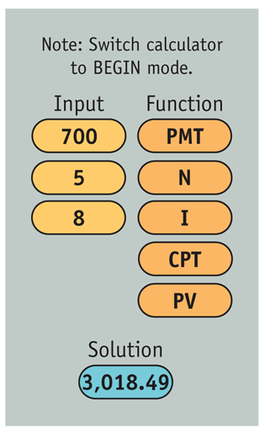

Finding the Present Value of an Annuity Due (cont.)
© 2012 Pearson Prentice Hall. All rights reserved.
5-<number>

Slide 37
Matter of Fact
Kansas truck driver, Donald Damon, got the surprise of his life when he learned he held the winning ticket for the Powerball lottery drawing held November 11, 2009. The advertised lottery jackpot was $96.6 million. Damon could have chosen to collect his prize in 30 annual payments of $3,220,000 (30 × $3.22 million = $96.6 million), but instead he elected to accept a lump sum payment of $48,367,329.08, roughly half the stated jackpot total.
© 2012 Pearson Prentice Hall. All rights reserved.
5-<number>

Slide 38
Finding the Present Value of a Perpetuity
A perpetuity is an annuity with an infinite life, providing continual annual cash flow.
If a perpetuity pays an annual cash flow of CF, starting one year from now, the present value of the cash flow stream is
PV = CF ÷ r
© 2012 Pearson Prentice Hall. All rights reserved.
5-<number>

Slide 39
Personal Finance Example
Ross Clark wishes to endow a chair in finance at his alma mater. The university indicated that it requires $200,000 per year to support the chair, and the endowment would earn 10% per year. To determine the amount Ross must give the university to fund the chair, we must determine the present value of a $200,000 perpetuity discounted at 10%.
PV = $200,000 ÷ 0.10 = $2,000,000
© 2012 Pearson Prentice Hall. All rights reserved.
5-<number>

Slide 40
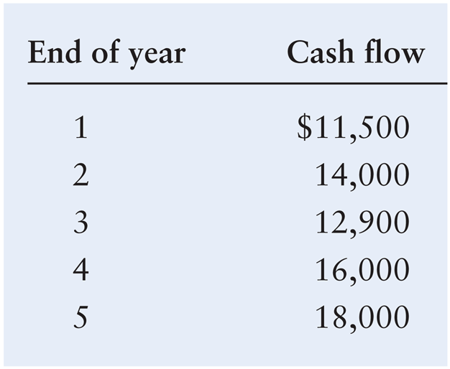
Future Value of a Mixed Stream
Shrell Industries, a cabinet manufacturer, expects to receive the following mixed stream of cash flows over the next 5 years from one of its small customers.
© 2012 Pearson Prentice Hall. All rights reserved.
5-<number>

Slide 41
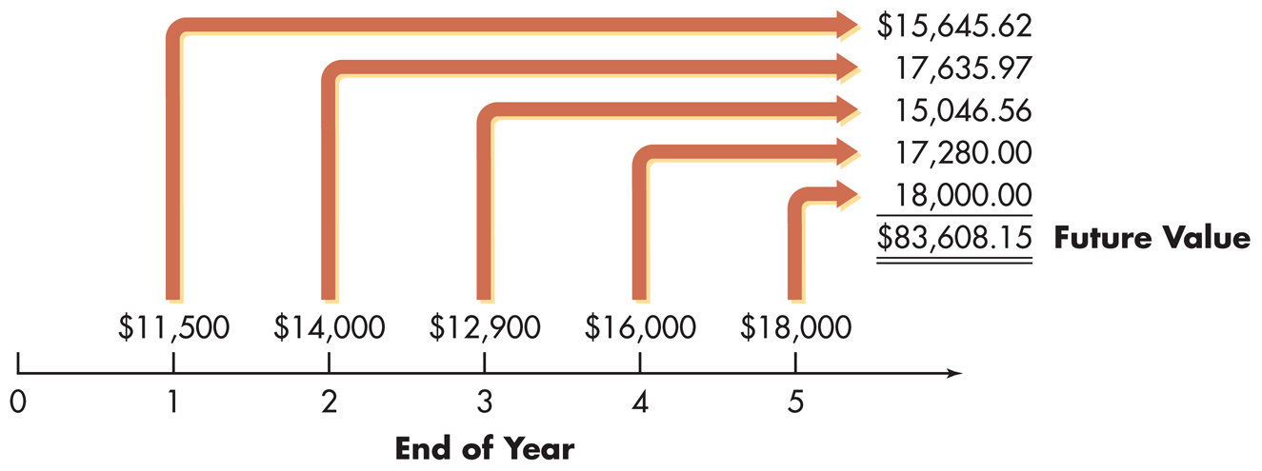
Future Value of a Mixed Stream
If the firm expects to earn at least 8% on its investments, how much will it accumulate by the end of year 5 if it immediately invests these cash flows when they are received?
This situation is depicted on the following time line.
© 2012 Pearson Prentice Hall. All rights reserved.
5-<number>

Slide 42
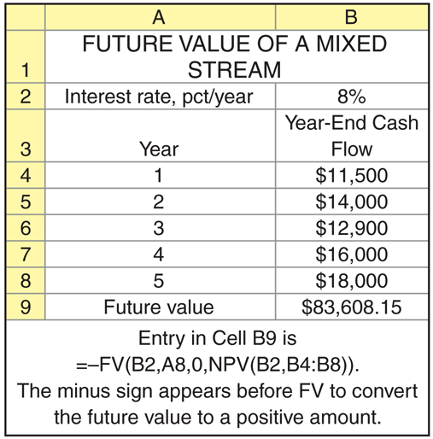
Future Value of a Mixed Stream (cont.)
© 2012 Pearson Prentice Hall. All rights reserved.
5-<number>

Slide 43
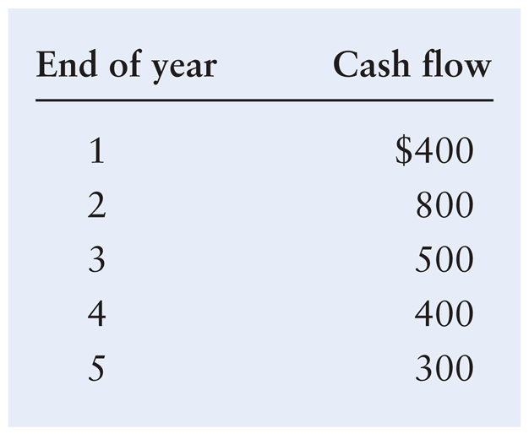
Present Value of a Mixed Stream
Frey Company, a shoe manufacturer, has been offered an opportunity to receive the following mixed stream of cash flows over the next 5 years.
© 2012 Pearson Prentice Hall. All rights reserved.
5-<number>

Slide 44
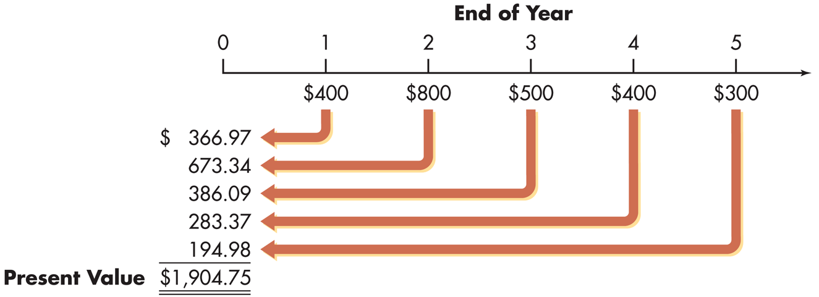
Present Value of a Mixed Stream
If the firm must earn at least 9% on its investments, what is the most it should pay for this opportunity?
This situation is depicted on the following time line.
© 2012 Pearson Prentice Hall. All rights reserved.
5-<number>

Slide 45
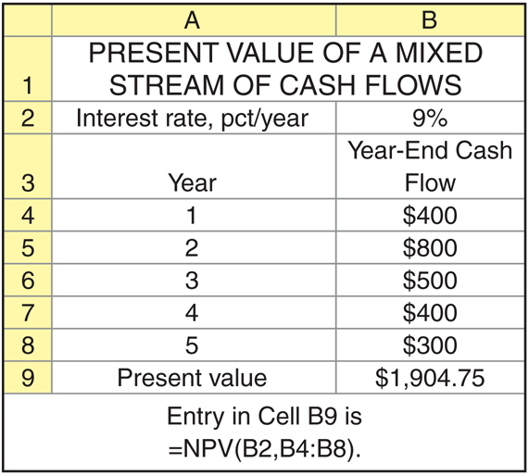
Present Value of a Mixed Stream (cont.)
© 2012 Pearson Prentice Hall. All rights reserved.
5-<number>

Slide 46
Compounding Interest More Frequently Than Annually
Compounding more frequently than once a year results in a higher effective interest rate because you are earning on interest on interest more frequently.
As a result, the effective interest rate is greater than the nominal (annual) interest rate.
Furthermore, the effective rate of interest will increase the more frequently interest is compounded.
© 2012 Pearson Prentice Hall. All rights reserved.
5-<number>

Slide 47
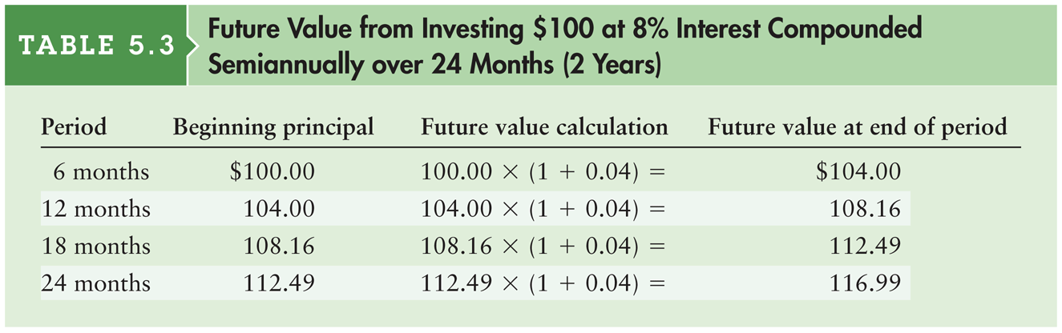
Table 5.3 Future Value from Investing $100 at 8% Interest Compounded Semiannually over 24 Months (2 Years)
© 2012 Pearson Prentice Hall. All rights reserved.
5-<number>

Slide 48
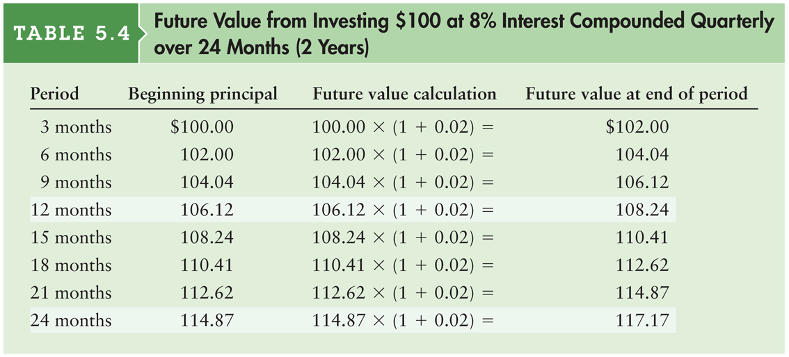
Table 5.4 Future Value from Investing $100 at 8% Interest Compounded Quarterly over 24 Months (2 Years)
© 2012 Pearson Prentice Hall. All rights reserved.
5-<number>

Slide 49
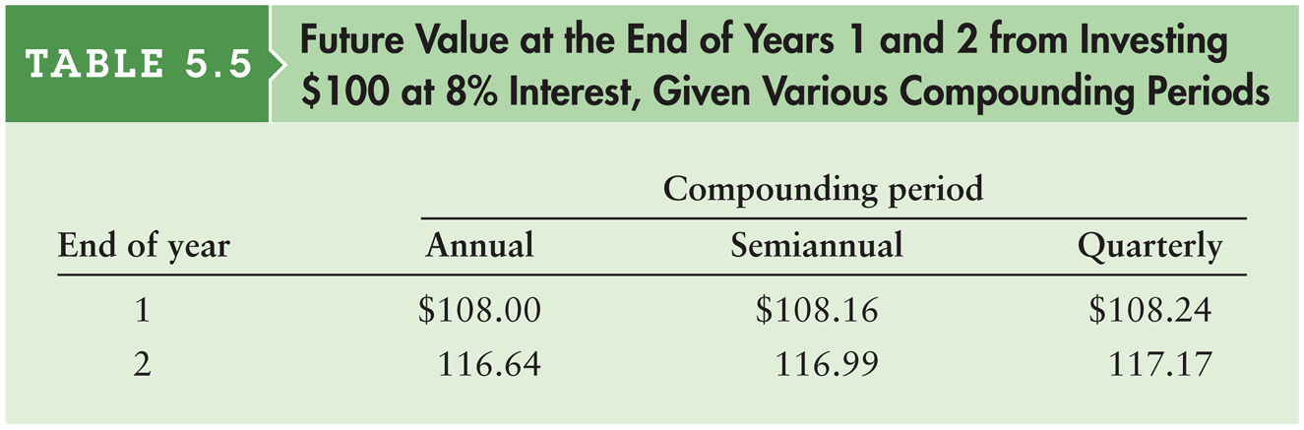
Table 5.5 Future Value from Investing $100 at 8% Interest Compounded Quarterly over 24 Months (2 Years)
© 2012 Pearson Prentice Hall. All rights reserved.
5-<number>

Slide 50

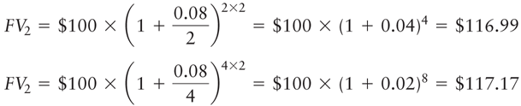
Compounding Interest More Frequently Than Annually (cont.)
A general equation for compounding more frequently than annually
Recalculate the example for the Fred Moreno example assuming (1) semiannual compounding and (2) quarterly compounding.
© 2012 Pearson Prentice Hall. All rights reserved.
5-<number>

Slide 51
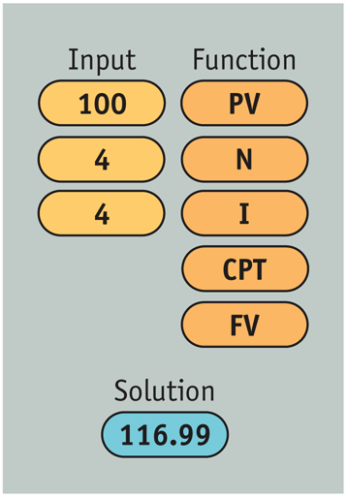

Compounding Interest More Frequently Than Annually (cont.)
© 2012 Pearson Prentice Hall. All rights reserved.
5-<number>

Slide 52
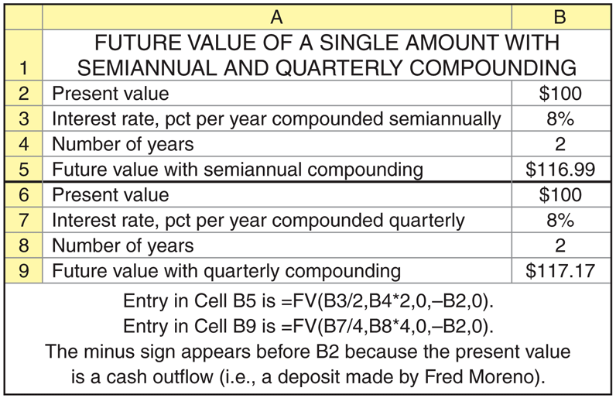
Compounding Interest More Frequently Than Annually (cont.)
© 2012 Pearson Prentice Hall. All rights reserved.
5-<number>

Slide 53

Continuous Compounding
Continuous compounding involves the compounding of interest an infinite number of times per year at intervals of microseconds.
A general equation for continuous compounding
where e is the exponential function.
© 2012 Pearson Prentice Hall. All rights reserved.
5-<number>

Slide 54
Personal Finance Example
Find the value at the end of 2 years (n = 2) of Fred Moreno’s $100 deposit (PV = $100) in an account paying 8% annual interest (r = 0.08) compounded continuously.
FV₂ (continuous compounding) = $100 × e^{0.08 × 2}
= $100 × 2.7183^{0.16}
= $100 × 1.1735 = $117.35
© 2012 Pearson Prentice Hall. All rights reserved.
5-<number>

Slide 55
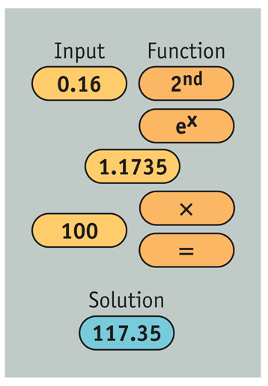
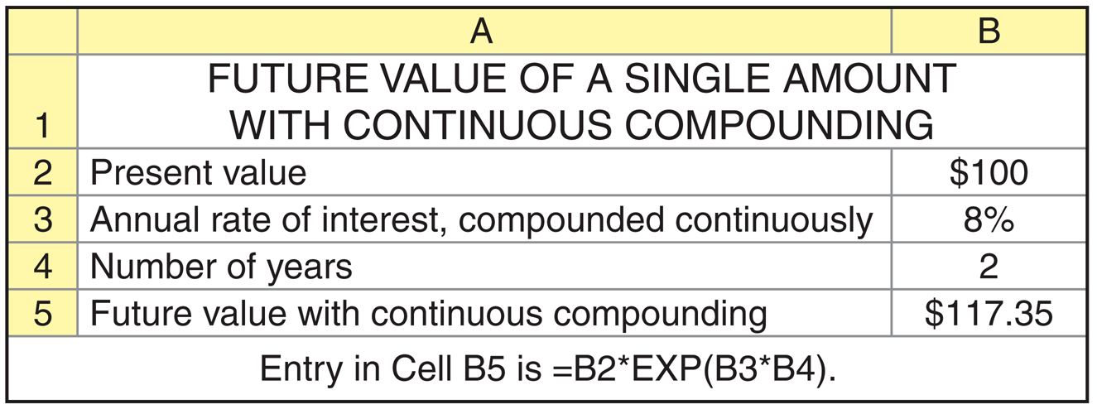
Personal Finance Example (cont.)
© 2012 Pearson Prentice Hall. All rights reserved.
5-<number>

Slide 56
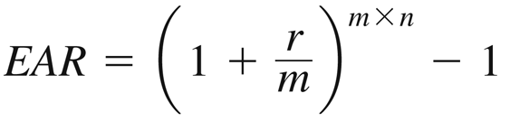
Nominal and Effective Annual Rates of Interest
The nominal (stated) annual rate is the contractual annual rate of interest charged by a lender or promised by a borrower.
The effective (true) annual rate (EAR) is the annual rate of interest actually paid or earned.
In general, the effective rate > nominal rate whenever compounding occurs more than once per year
© 2012 Pearson Prentice Hall. All rights reserved.
5-<number>

Slide 57
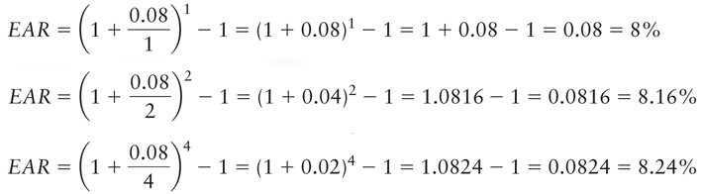
Personal Finance Example
Fred Moreno wishes to find the effective annual rate associated with an 8% nominal annual rate (r = 0.08) when interest is compounded (1) annually (m = 1); (2) semiannually (m = 2); and (3) quarterly (m = 4).
© 2012 Pearson Prentice Hall. All rights reserved.
5-<number>

Slide 58
Focus on Ethics
How Fair Is “Check Into Cash”?
  There are more than 1,100 Check Into Cash centers among an estimated 22,000 payday-advance lenders in the United States.
  A payday loan is a small, unsecured, short-term loan ranging from $100 to $1,000 (depending upon the state) offered by a payday lender.
  A borrower who rolled over an initial $100 loan for the maximum of four times would accumulate a total of $75 in fees all within a 10-week period.
  On an annualized basis, the fees would amount to a whopping 391%.
  The 391% mentioned above is an annual nominal rate [15% × (365/14)]. Should the 2-week rate (15%) be compounded to calculate the effective annual interest rate?
© 2012 Pearson Prentice Hall. All rights reserved.
5-<number>

Slide 59

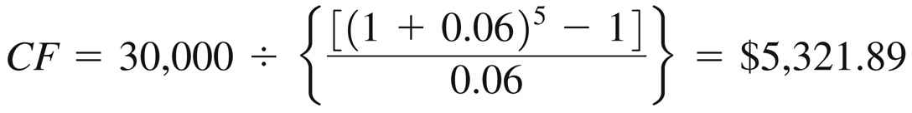
Special Applications of Time Value: Deposits Needed to Accumulate a Future Sum
The following equation calculates the annual cash payment (CF) that we’d have to save to achieve a future value (FV_{n}):
Suppose you want to buy a house 5 years from now, and you estimate that an initial down payment of $30,000 will be required at that time. To accumulate the $30,000, you will wish to make equal annual end-of-year deposits into an account paying annual interest of 6 percent.
© 2012 Pearson Prentice Hall. All rights reserved.
5-<number>

Slide 60
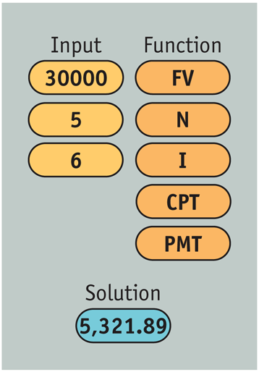
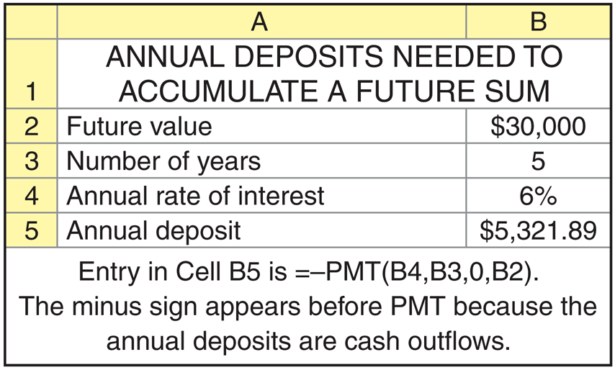
Personal Finance Example
© 2012 Pearson Prentice Hall. All rights reserved.
5-<number>

Slide 61
Special Applications of Time Value: Loan Amortization
Loan amortization is the determination of the equal periodic loan payments necessary to provide a lender with a specified interest return and to repay the loan principal over a specified period.
The loan amortization process involves finding the future payments, over the term of the loan, whose present value at the loan interest rate equals the amount of initial principal borrowed.
A loan amortization schedule is a schedule of equal payments to repay a loan. It shows the allocation of each loan payment to interest and principal.
© 2012 Pearson Prentice Hall. All rights reserved.
5-<number>

Slide 62

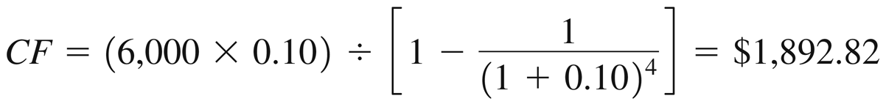
Special Applications of Time Value: Loan Amortization (cont.)
The following equation calculates the equal periodic loan payments (CF) necessary to provide a lender with a specified interest return and to repay the loan principal (PV) over a specified period:
Say you borrow $6,000 at 10 percent and agree to make equal annual end-of-year payments over 4 years. To find the size of the payments, the lender determines the amount of a 4-year annuity discounted at 10 percent that has a present value of $6,000.
© 2012 Pearson Prentice Hall. All rights reserved.
5-<number>

Slide 63
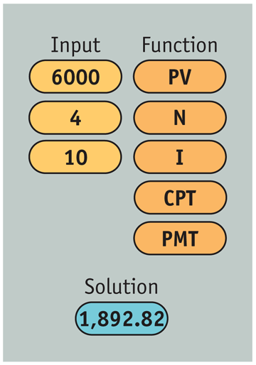
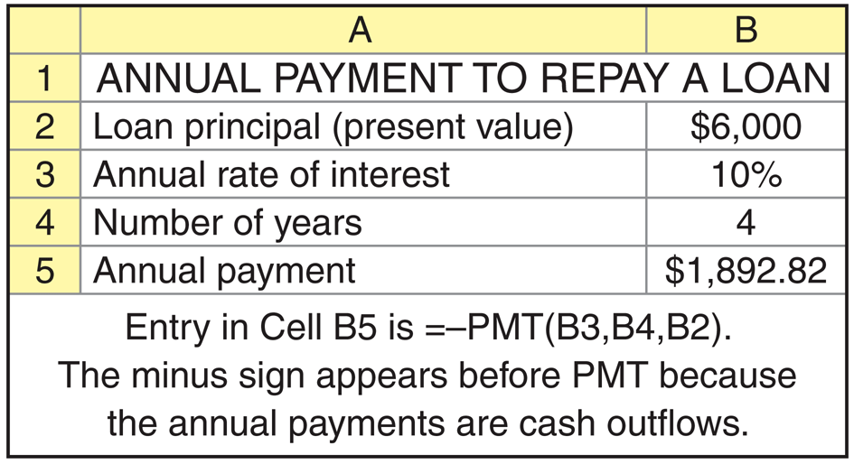
Personal Finance Example
© 2012 Pearson Prentice Hall. All rights reserved.
5-<number>

Slide 64
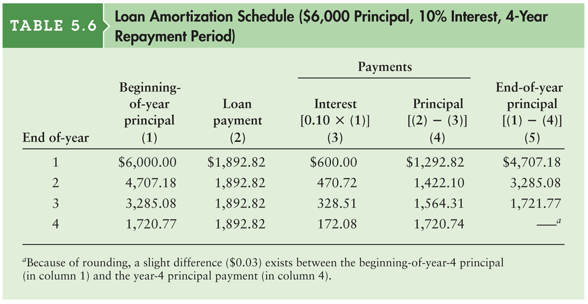
Table 5.6 Loan Amortization Schedule
($6,000 Principal, 10% Interest, 4-Year Repayment Period)
© 2012 Pearson Prentice Hall. All rights reserved.
5-<number>

Slide 65
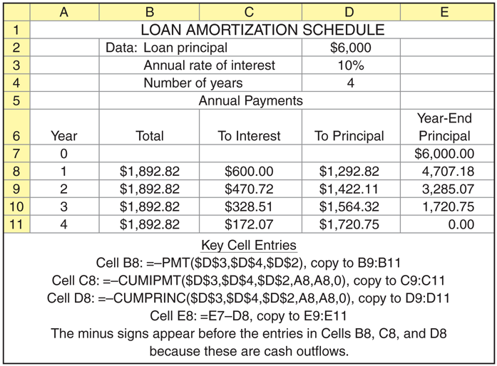
Personal Finance Example (cont.)
© 2012 Pearson Prentice Hall. All rights reserved.
5-<number>

Slide 66
Focus on Practice
New Century Brings Trouble for Subprime Mortgages
In 2006, some $300 billion worth of adjustable ARMs were reset to higher rates.
In a market with rising home values, a borrower has the option to refinance their mortgage, using some of the equity created by the home’s increasing value to reduce the mortgage payment.
But after 2006, home prices started a three-year slide, so refinancing was not an option for many subprime borrowers.
As a reaction to problems in the subprime area, lenders tightened lending standards. What effect do you think this had on the housing market?
© 2012 Pearson Prentice Hall. All rights reserved.
5-<number>

Slide 67

Special Applications of Time Value: Finding Interest or Growth Rates
It is often necessary to calculate the compound annual interest or growth rate (that is, the annual rate of change in values) of a series of cash flows.
The following equation is used to find the interest rate (or growth rate) representing the increase in value of some investment between two time periods.
© 2012 Pearson Prentice Hall. All rights reserved.
5-<number>

Slide 68
Personal Finance Example
Ray Noble purchased an investment four years ago for $1,250. Now it is worth $1,520. What compound annual rate of return has Ray earned on this investment? Plugging the appropriate values into Equation 5.20, we have:
r = ($1,520 ÷ $1,250)^{(1/4)} – 1 = 0.0501 = 5.01% per year
© 2012 Pearson Prentice Hall. All rights reserved.
5-<number>

Slide 69
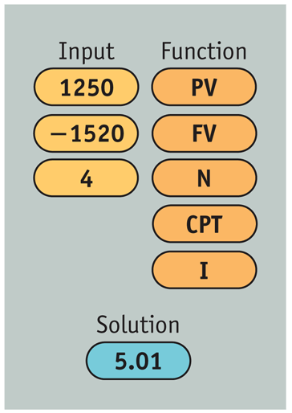
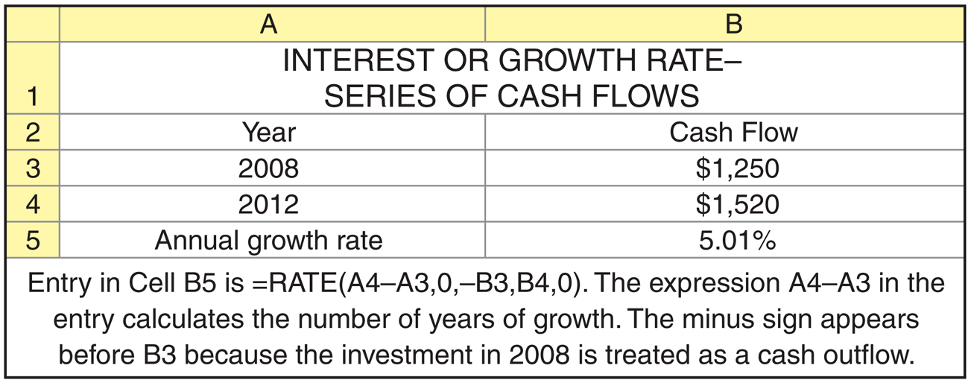
Personal Finance Example (cont.)
© 2012 Pearson Prentice Hall. All rights reserved.
5-<number>

Slide 70
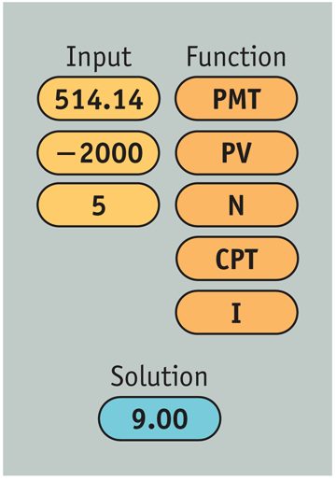
Personal Finance Example
Jan Jacobs can borrow $2,000 to be repaid in equal annual end-of-year amounts of $514.14 for the next 5 years. She wants to find the interest rate on this loan.
© 2012 Pearson Prentice Hall. All rights reserved.
5-<number>

Slide 71
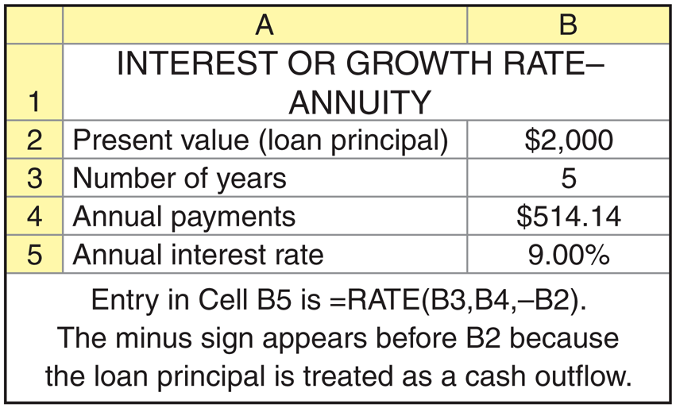
Personal Finance Example (cont.)
© 2012 Pearson Prentice Hall. All rights reserved.
5-<number>

Slide 72
Special Applications of Time Value: Finding an Unknown Number of Periods
Sometimes it is necessary to calculate the number of time periods needed to generate a given amount of cash flow from an initial amount.
This simplest case is when a person wishes to determine the number of periods, n, it will take for an initial deposit, PV, to grow to a specified future amount, FV_{n}, given a stated interest rate, r.
© 2012 Pearson Prentice Hall. All rights reserved.
5-<number>

Slide 73

Personal Finance Example
Ann Bates wishes to determine the number of years it will take for her initial $1,000 deposit, earning 8% annual interest, to grow to equal $2,500. Simply stated, at an 8% annual rate of interest, how many years, n, will it take for Ann’s $1,000, PV, to grow to $2,500, FV_{n}?
© 2012 Pearson Prentice Hall. All rights reserved.
5-<number>

Slide 74

Personal Finance Example (cont.)
© 2012 Pearson Prentice Hall. All rights reserved.
5-<number>

Slide 75

Personal Finance Example
Bill Smart can borrow $25,000 at an 11% annual interest rate; equal, annual, end-of-year payments of $4,800 are required. He wishes to determine how long it will take to fully repay the loan. In other words, he wishes to determine how many years, n, it will take to repay the $25,000, 11% loan, PV_{n}, if the payments of $4,800 are made at the end of each year.
© 2012 Pearson Prentice Hall. All rights reserved.
5-<number>

Slide 76

Personal Finance Example (cont.)
© 2012 Pearson Prentice Hall. All rights reserved.
5-<number>

Slide 77
Review of Learning Goals
LG1 Discuss the role of time value in finance, the use of computational tools, and the basic patterns of cash flow.
  Financial managers and investors use time-value-of-money techniques when assessing the value of expected cash flow streams. Alternatives can be assessed by either compounding to find future value or discounting to find present value. Financial managers rely primarily on present value techniques. The cash flow of a firm can be described by its pattern—single amount, annuity, or mixed stream.
© 2012 Pearson Prentice Hall. All rights reserved.
5-<number>

Slide 78
Review of Learning Goals (cont.)
LG2 Understand the concepts of future value and present value, their calculation for single amounts, and the relationship between them.
  Future value (FV) relies on compound interest to measure future amounts: The initial principal or deposit in one period, along with the interest earned on it, becomes the beginning principal of the following period.
  The present value (PV) of a future amount is the amount of money today that is equivalent to the given future amount, considering the return that can be earned. Present value is the inverse of future value.
© 2012 Pearson Prentice Hall. All rights reserved.
5-<number>

Slide 79
Review of Learning Goals (cont.)
LG3 Find the future value and the present value of both an ordinary annuity and an annuity due, and find the present value of a perpetuity.
  The future or present value of an ordinary annuity can be found by using algebraic equations, a financial calculator, or a spreadsheet program. The value of an annuity due is always r% greater than the value of an identical annuity. The present value of a perpetuity—an infinite-lived annuity—is found using 1 divided by the discount rate to represent the present value interest factor.
© 2012 Pearson Prentice Hall. All rights reserved.
5-<number>

Slide 80
Review of Learning Goals (cont.)
LG4 Calculate both the future value and the present value of a mixed stream of cash flows.
  A mixed stream of cash flows is a stream of unequal periodic cash flows that reflect no particular pattern. The future value of a mixed stream of cash flows is the sum of the future values of each individual cash flow. Similarly, the present value of a mixed stream of cash flows is the sum of the present values of the individual cash flows.
© 2012 Pearson Prentice Hall. All rights reserved.
5-<number>

Slide 81
Review of Learning Goals (cont.)
LG5 Understand the effect that compounding interest more frequently than annually has on future value and the effective annual rate of interest.
  Interest can be compounded at intervals ranging from annually to daily, and even continuously. The more often interest is compounded, the larger the future amount that will be accumulated, and the higher the effective, or true, annual rate (EAR).
© 2012 Pearson Prentice Hall. All rights reserved.
5-<number>

Slide 82
Review of Learning Goals (cont.)
LG6 Describe the procedures involved in (1) determining deposits needed to accumulate a future sum, (2) loan amortization, (3) finding interest or growth rates, and (4) finding an unknown number of periods.
  (1) The periodic deposit to accumulate a given future sum can be found by solving the equation for the future value of an annuity for the annual payment. (2) A loan can be amortized into equal periodic payments by solving the equation for the present value of an annuity for the periodic payment. (3) Interest or growth rates can be estimated by finding the unknown interest rate in the equation for the present value of a single amount or an annuity. (4) An unknown number of periods can be estimated by finding the unknown number of periods in the equation for the present value of a single amount or an annuity.
© 2012 Pearson Prentice Hall. All rights reserved.
5-<number>

Slide 83
Chapter Resources on MyFinanceLab
Chapter Cases
Group Exercises
Critical Thinking Problems
© 2012 Pearson Prentice Hall. All rights reserved.
5-<number>

Slide 84

Integrative Case: Track Software, Inc.
Table 1: Track Software, Inc. Profit, Dividends, and Retained Earnings, 2006–2012
© 2012 Pearson Prentice Hall. All rights reserved.
5-<number>

Slide 85

Integrative Case: Track Software, Inc.
Table 2: Track Software, Inc. Income Statement ($000)for the Year Ended December 31, 2012
© 2012 Pearson Prentice Hall. All rights reserved.
5-<number>

Slide 86

Integrative Case: Track Software, Inc.
Table 3a: Track Software, Inc. Balance Sheet ($000)
© 2012 Pearson Prentice Hall. All rights reserved.
5-<number>

Slide 87

Integrative Case: Track Software, Inc.
Table 3b: Track Software, Inc. Balance Sheet ($000)
© 2012 Pearson Prentice Hall. All rights reserved.
5-<number>

Slide 88

Integrative Case: Track Software, Inc.
Table 4: Track Software, Inc. Statement of Retained Earnings ($000) for the Year Ended December 31, 2012
© 2012 Pearson Prentice Hall. All rights reserved.
5-<number>

Slide 89

Integrative Case: Track Software, Inc.
Table 5: Track Software, Inc. Profit, Dividends, and Retained Earnings, 2006–2012
© 2012 Pearson Prentice Hall. All rights reserved.
5-<number>

Slide 90
Integrative Case: Track Software, Inc.
Upon what financial goal does Stanley seem to be focusing? Is it the correct goal? Why or why not?
Could a potential agency problem exist in this firm? Explain.
Calculate the firm’s earnings per share (EPS) for each year, recognizing that the number of shares of common stock outstanding has remained unchanged since the firm’s inception. Comment on the EPS performance in view of your response in part a.
Use the financial data presented to determine Track’s operating cash flow (OCF) and free cash flow (FCF) in 2012. Evaluate your findings in light of Track’s current cash flow difficulties.
© 2012 Pearson Prentice Hall. All rights reserved.
5-<number>

Slide 91
Integrative Case: Track Software, Inc.
Analyze the firm’s financial condition in 2012 as it relates to (1) liquidity, (2) activity, (3) debt, (4) profitability, and (5) market, using the financial statements provided in Tables 2 and 3 and the ratio data included in Table 5. Be sure to evaluate the firm on both a cross-sectional and a time-series basis.
What recommendation would you make to Stanley regarding hiring a new software developer? Relate your recommendation here to your responses in part a.
© 2012 Pearson Prentice Hall. All rights reserved.
5-<number>

Slide 92
Integrative Case: Track Software, Inc.
Track Software paid $5,000 in dividends in 2012. Suppose an investor approached Stanley about buying 100% of his firm. If this investor believed that by owning the company he could extract $5,000 per year in cash from the company in perpetuity, what do you think the investor would be willing to pay for the firm if the required return on this investment is 10%?
Suppose that you believed that the FCF generated by Track Software in 2012 could continue forever. You are willing to buy the company in order to receive this perpetual stream of free cash flow. What are you willing to pay if you require a 10% return on your investment?
© 2012 Pearson Prentice Hall. All rights reserved.
5-<number>

